Slide 1
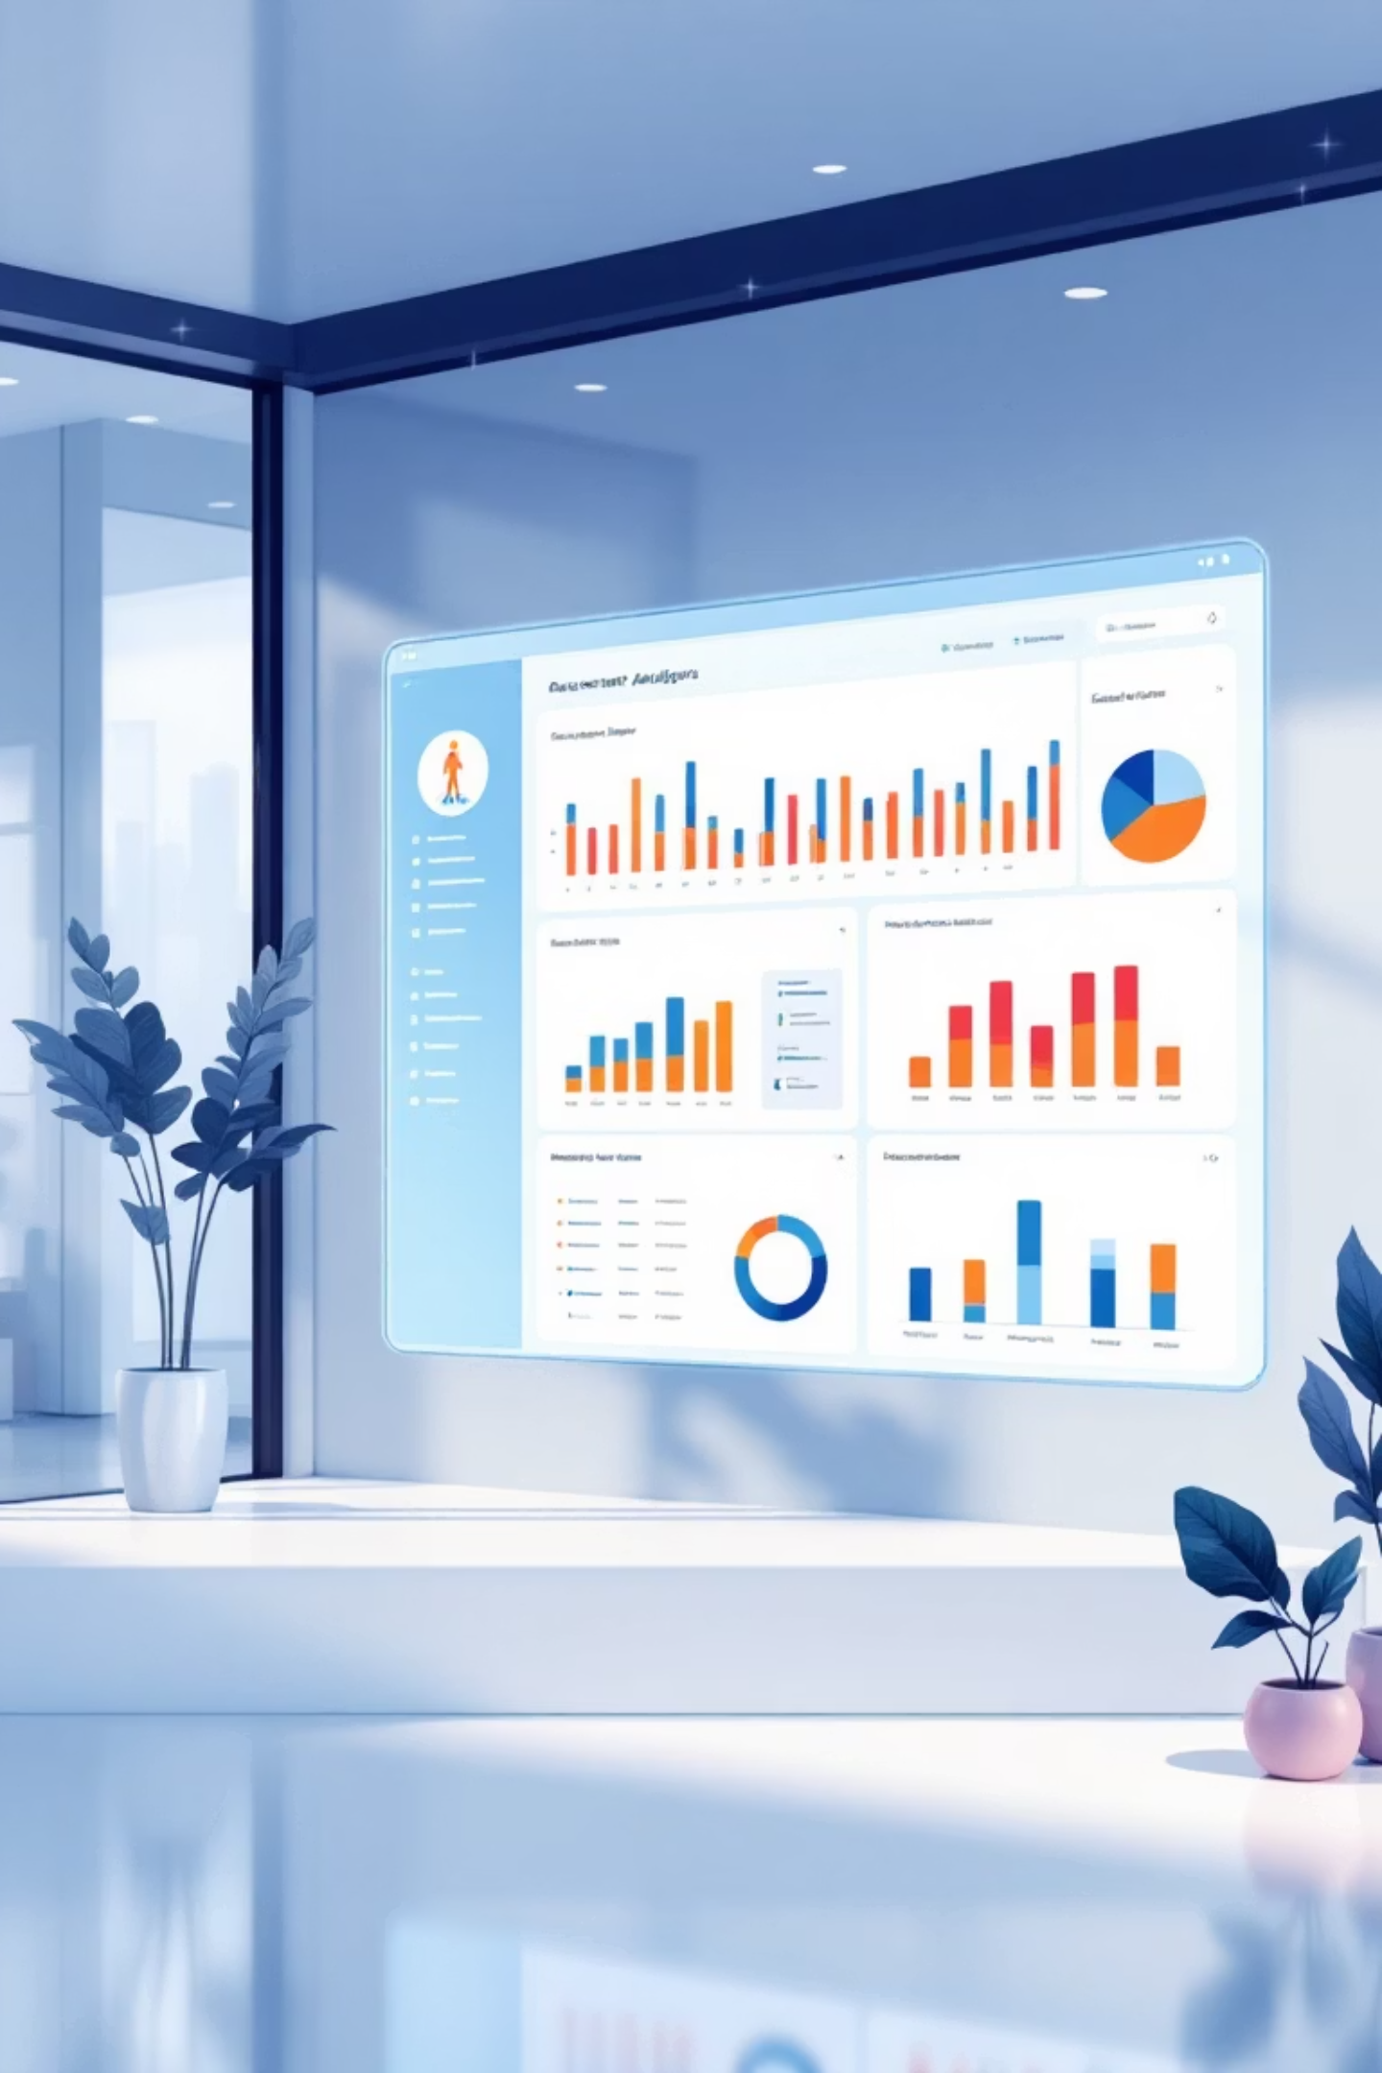
Customer Shopping Behaviour Analysis
An end-to-end analytical workflow uncovering meaningful insights from 3,900 customer purchases across multiple product categories. This comprehensive analysis integrates Python for data preparation, SQL for structured business analysis, and Power BI for interactive visualization, forming a complete data analytics pipeline to support strategic decision-making.
Submitted By: Khatri Lalita C. | Roll No: 5119 | Division: A | Group ID: 27
Programme: Semester IX of V Year M.Sc (CA&IT) (2025-26)
Institution: K.S. School of Business Management & Information Technology

Slide 2

Project Overview & Objectives
Project Scope
Technology Stack
This project presents a comprehensive analytical workflow designed to extract actionable insights from customer purchase data. The analysis encompasses customer demographics, shopping habits, discount behaviour, subscription status, and product preferences to enable data-driven strategic decisions.
Python: Data cleaning, preprocessing, feature engineering, and preparation
SQL (PostgreSQL): Structured business queries and analytical insights
Power BI: Interactive dashboards and visual storytelling
Pandas & NumPy: Data manipulation and statistical analysis
The workflow demonstrates a complete data analytics pipeline, seamlessly integrating multiple tools and technologies to transform raw data into meaningful business intelligence.
3,900 Records
18 Attributes
10 Business Questions
Total customer transactions analysed
Comprehensive data dimensions
Strategic insights delivered

Slide 3

Dataset Summary & Structure
Dataset Scale
Customer Demographics
Purchase Behaviour
Total Records: 3,900 customer transactions
Age and Age Group classifications
Purchase Amount values
Columns: 18 distinct attributes
Gender distribution
Purchase Frequency metrics
Data Types: Numerical, categorical, and behavioural attributes
Location information
Previous Purchases history
Subscription Status tracking
Transaction timestamps
Product Attributes
Transaction Details
Category classifications (Clothing, Accessories, Footwear, Outerwear)
Season of purchase (Spring, Summer, Fall, Winter)
Item Purchased specifications
Discount Applied status
Size variations
Review Rating (1-5 scale)
Colour preferences
Shipping Type (Standard, Express, Free Shipping)
Data Quality Note: The dataset contained 37 missing entries in the Review Rating column, which were systematically handled during the preprocessing phase using category-level median imputation to maintain data integrity and analytical accuracy.

Slide 4
Data Preparation in Python
The raw dataset required comprehensive cleaning, restructuring, and feature engineering before meaningful analysis could begin. The Python-based data preparation phase ensured data quality, consistency, and analytical readiness through a systematic approach.
01
02
03
Data Loading & Initial Exploration
Handling Missing Values
Feature Engineering
Imported the dataset using pandas library and conducted initial exploration using .info() and .describe() methods to understand data structure, types, and statistical distributions.
Identified 37 missing values exclusively in the review_rating column. Applied category-level median imputation to preserve data integrity whilst maintaining statistical validity across product categories.
Created age_group variable using binning techniques (Young Adult, Middle-aged, Adult, Senior). Added purchase_frequency_days based on purchase intervals. Standardised all column names to snake_case format for improved readability and consistency.
04
05
Data Validation
Python-SQL Integration
Conducted redundancy checks and removed promo_code_used column as its behaviour overlapped with discount_applied, eliminating data duplication and improving analytical clarity.
Exported the cleaned and validated DataFrame into a PostgreSQL database, enabling structured query execution and deeper business analysis through SQL-based investigations.

Slide 5



SQL-Based Business Analysis: Key Insights
A comprehensive series of SQL queries were executed to answer ten strategic business questions, extracting actionable insights from the prepared dataset. These queries formed the analytical foundation for business recommendations and dashboard visualisation.
Revenue by Gender
High-Spending Discount Users
Top-Rated Products
Male customers generated higher overall spending, whilst females demonstrated stronger engagement in specific product categories, indicating distinct purchasing patterns.
Customers utilising discounts whilst exceeding average purchase amounts represent a valuable segment with strong purchasing power and price sensitivity.
Gloves, Sandals, Boots, Hat, and Skirt emerged as top performers based on average review ratings, indicating high customer satisfaction.
Shipping & Subscription Insights
Product & Customer Segmentation
Shipping Type Impact: Express shipping customers exhibited significantly higher average spending, suggesting a premium user segment willing to pay for convenience and speed.
Discount Dependency: Hats, Sneakers, Coats, Sweaters, and Pants showed high reliance on discounts to drive sales volumes.
Subscribers vs. Non-Subscribers: Subscribers generated higher average spend per transaction, whilst non-subscribers contributed higher total revenue due to larger transaction volumes.
Customer Segments:
Loyal: 3,116 customers
Returning: 701 customers
New: 83 customers
3,116
701
83
Loyal Customers
Returning Customers
New Customers
Representing the largest segment with consistent purchasing behaviour
Demonstrating repeat purchase patterns and brand affinity
Fresh acquisitions with growth potential

Slide 6
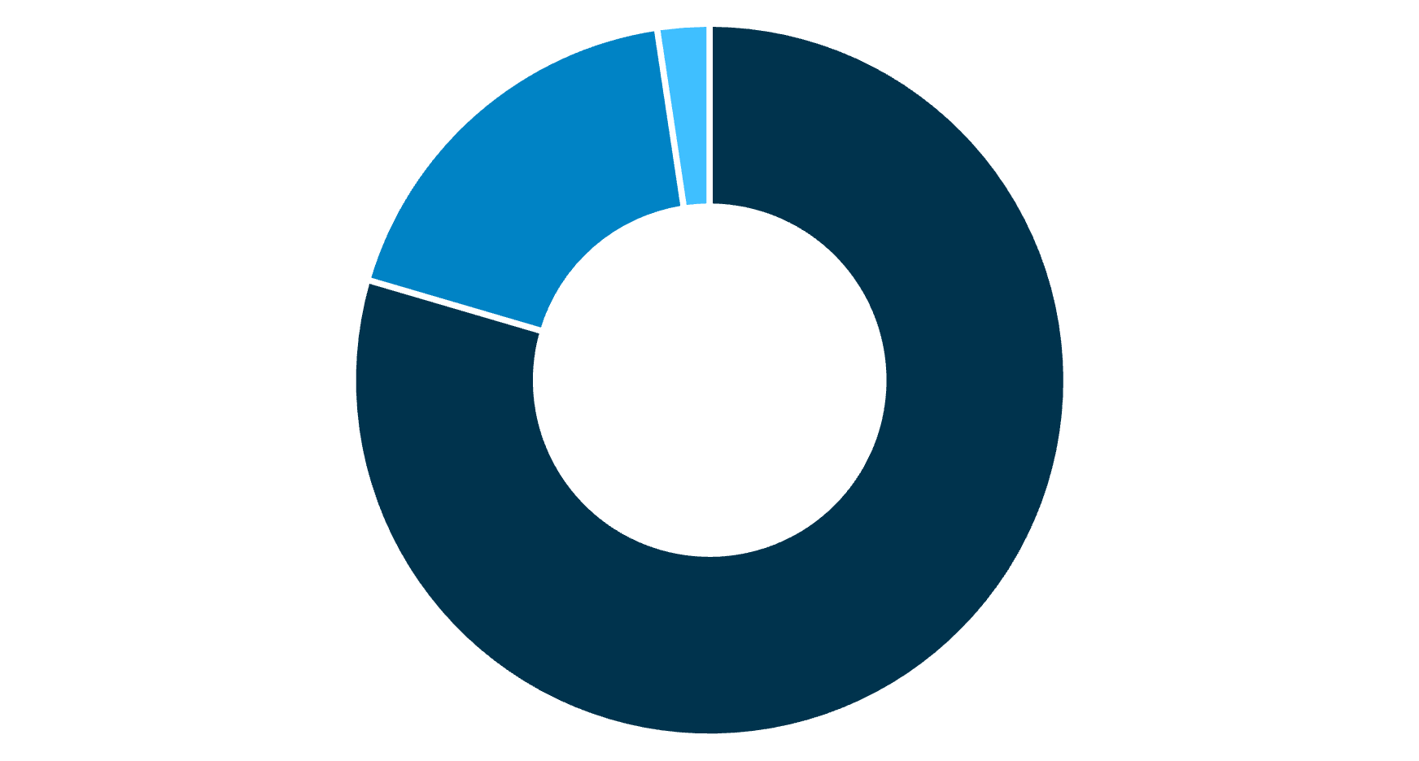




Customer Segmentation and Product Performance
Customer Segmentation Analysis
Top Items per Category
Accessories
Jewellery leads the category with highest sales and customer preference
Clothing
Blouse ranks as the top-performing clothing item across all segments
Loyal
Returning
New
Footwear
The customer base is predominantly composed of Loyal customers (3,116), representing 79.9% of the total. Returning customers account for 18.0% (701), whilst New customers represent only 2.1% (83). This distribution indicates strong customer retention but highlights opportunities for new customer acquisition strategies.
Sandals dominate footwear sales with consistent customer demand
Outerwear
Jacket emerges as the preferred outerwear choice amongst customers
Analysis reveals that repeat buyers (customers with more than 5 purchases) were significantly more likely to subscribe to the service, demonstrating a clear correlation between purchase frequency and subscription conversion rates. This insight is crucial for developing targeted subscription marketing campaigns.

Slide 7
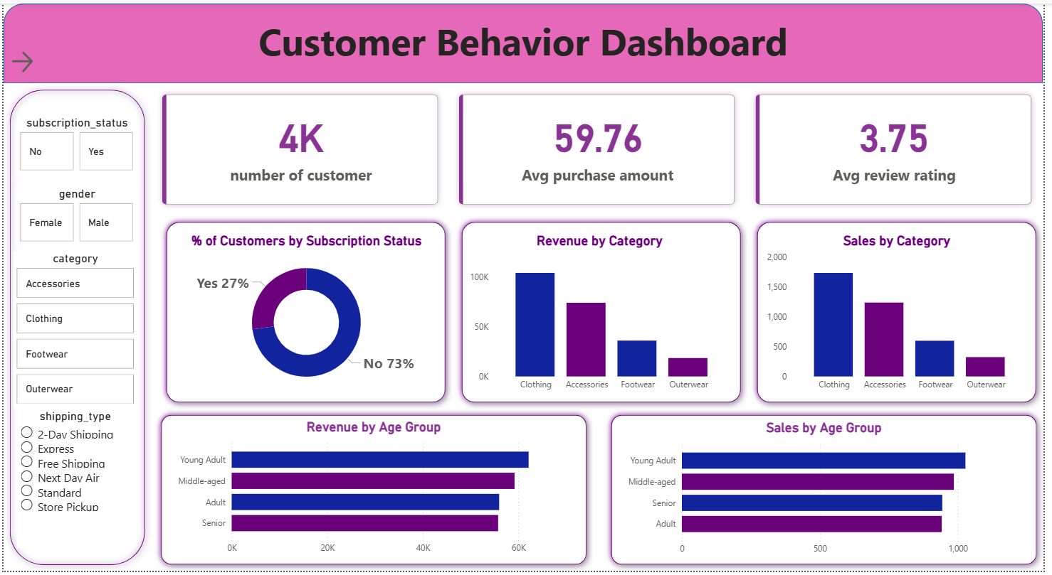
Customer Behavior Dashboard
Key Revenue Insights
39%
30%
Young Adults contribute the highest revenue to the business, generating approximately ₹1,85,000, followed by Middle-aged customers at ₹1,42,000. Adult customers contribute ₹98,000, whilst Senior customers account for ₹45,000 in revenue.
Young Adult Share
Middle-aged Share
This distribution suggests that marketing efforts should prioritise Young Adult and Middle-aged segments, whilst also exploring opportunities to increase engagement with Adult and Senior demographics through tailored product offerings and communication strategies.
Highest revenue contribution segment
Second largest revenue contributor
21%
10%
Adult Share
Senior Share
Moderate revenue contribution
Opportunity for growth segment

Slide 8
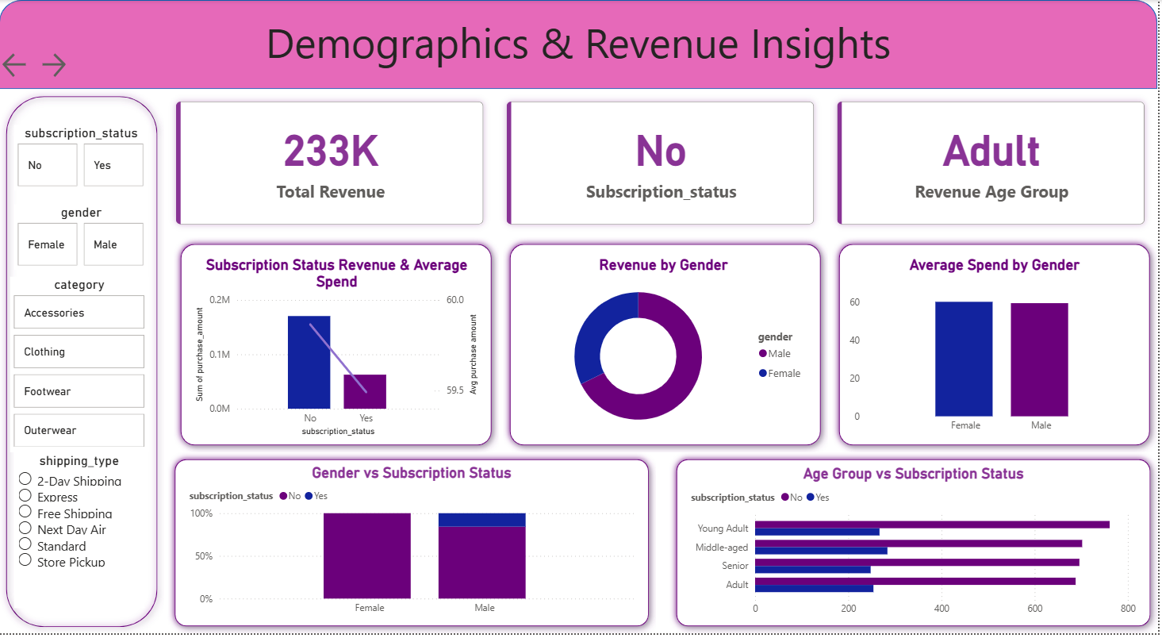
Demographics & Revenue Insights
Key Revenue Insights
39%
30%
Young Adults contribute the highest revenue to the business, generating approximately ₹1,85,000, followed by Middle-aged customers at ₹1,42,000. Adult customers contribute ₹98,000, whilst Senior customers account for ₹45,000 in revenue.
Young Adult Share
Middle-aged Share
This distribution suggests that marketing efforts should prioritise Young Adult and Middle-aged segments, whilst also exploring opportunities to increase engagement with Adult and Senior demographics through tailored product offerings and communication strategies.
Highest revenue contribution segment
Second largest revenue contributor
21%
10%
Adult Share
Senior Share
Moderate revenue contribution
Opportunity for growth segment

Slide 9
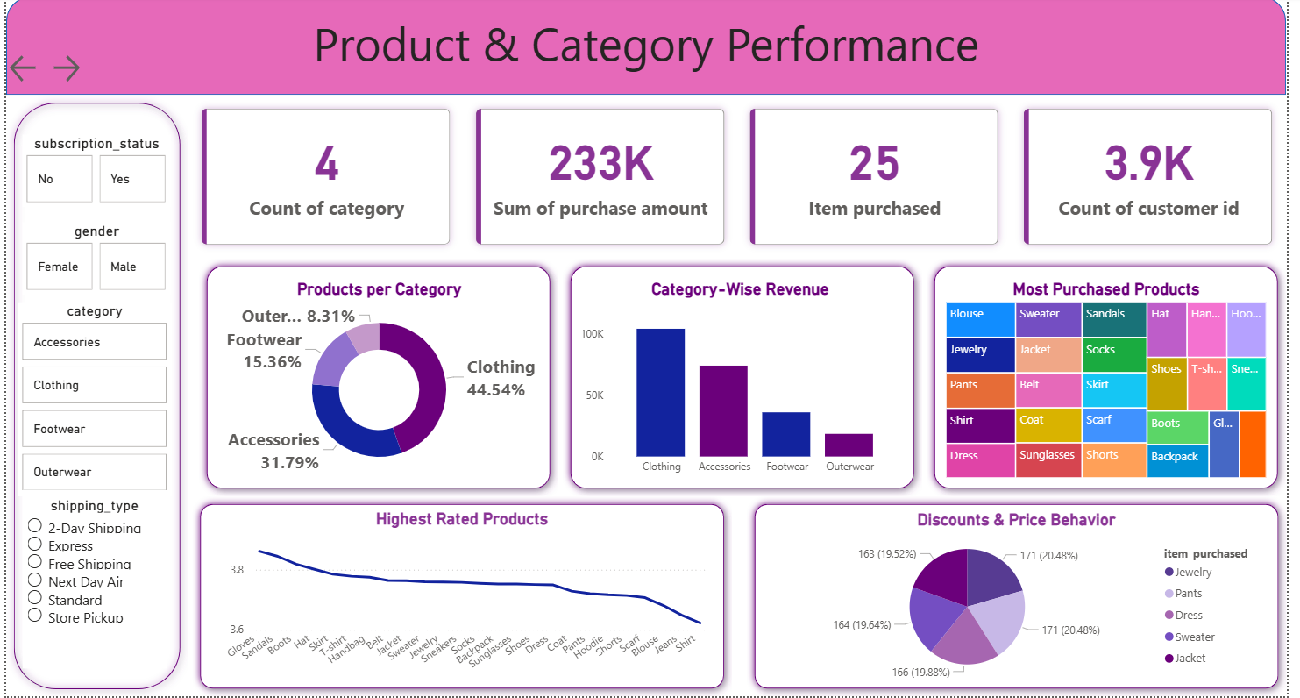
Product & Category Performance
Key Revenue Insights
39%
30%
Young Adults contribute the highest revenue to the business, generating approximately ₹1,85,000, followed by Middle-aged customers at ₹1,42,000. Adult customers contribute ₹98,000, whilst Senior customers account for ₹45,000 in revenue.
Young Adult Share
Middle-aged Share
This distribution suggests that marketing efforts should prioritise Young Adult and Middle-aged segments, whilst also exploring opportunities to increase engagement with Adult and Senior demographics through tailored product offerings and communication strategies.
Highest revenue contribution segment
Second largest revenue contributor
21%
10%
Adult Share
Senior Share
Moderate revenue contribution
Opportunity for growth segment

Slide 10
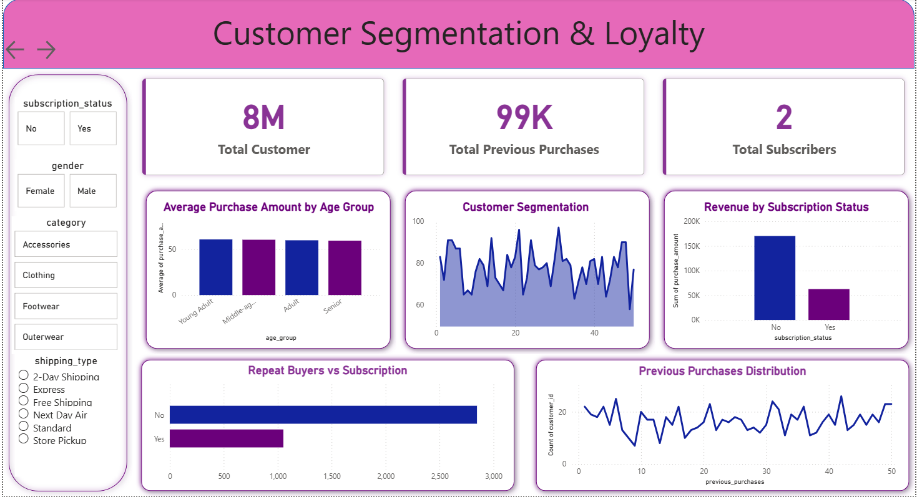
Customer Segmentation & Loyalty
Key Revenue Insights
39%
30%
Young Adults contribute the highest revenue to the business, generating approximately ₹1,85,000, followed by Middle-aged customers at ₹1,42,000. Adult customers contribute ₹98,000, whilst Senior customers account for ₹45,000 in revenue.
Young Adult Share
Middle-aged Share
This distribution suggests that marketing efforts should prioritise Young Adult and Middle-aged segments, whilst also exploring opportunities to increase engagement with Adult and Senior demographics through tailored product offerings and communication strategies.
Highest revenue contribution segment
Second largest revenue contributor
21%
10%
Adult Share
Senior Share
Moderate revenue contribution
Opportunity for growth segment

Slide 11
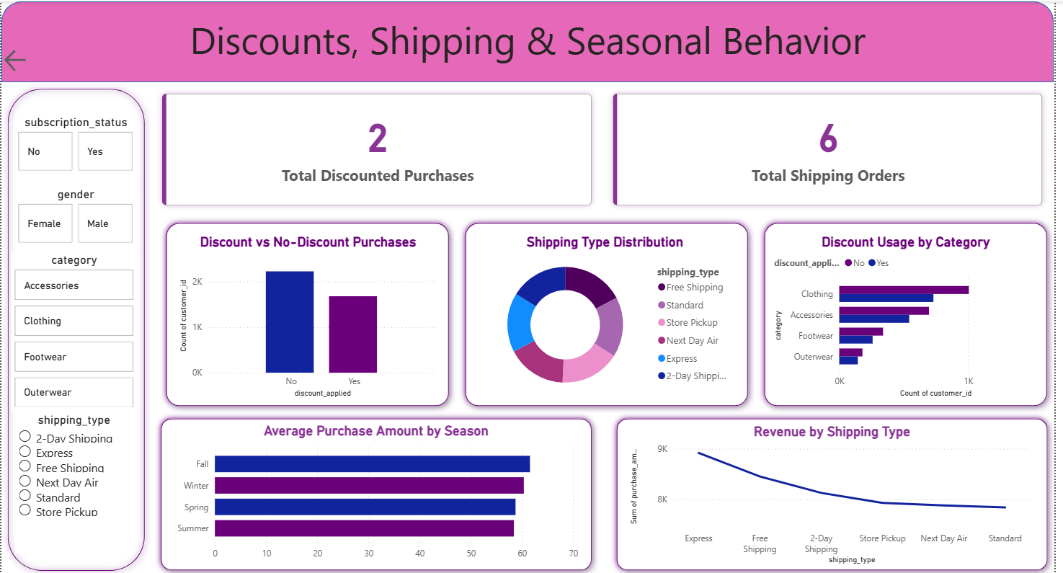
Discounts, Shipping & Seasonal Behavior
Key Revenue Insights
39%
30%
Young Adults contribute the highest revenue to the business, generating approximately ₹1,85,000, followed by Middle-aged customers at ₹1,42,000. Adult customers contribute ₹98,000, whilst Senior customers account for ₹45,000 in revenue.
Young Adult Share
Middle-aged Share
This distribution suggests that marketing efforts should prioritise Young Adult and Middle-aged segments, whilst also exploring opportunities to increase engagement with Adult and Senior demographics through tailored product offerings and communication strategies.
Highest revenue contribution segment
Second largest revenue contributor
21%
10%
Adult Share
Senior Share
Moderate revenue contribution
Opportunity for growth segment

Slide 12




Power BI Dashboard: Overview
The Power BI dashboard serves as the visual centrepiece of this analysis, transforming complex data insights into an interactive, user-friendly interface. The dashboard integrates findings from both Python preprocessing and SQL business analysis, presenting them through intuitive visualisations that enable stakeholders to explore data dynamically and derive actionable insights.
Key Performance Indicators
Interactive Filters
Prominently displays critical metrics including total number of customers (3,900), average purchase amount, and average review rating, providing immediate visibility into business health and customer satisfaction levels.
Enables dynamic data exploration through multiple filter dimensions including Shipping Type, Gender, and Product Category, allowing users to drill down into specific segments and uncover granular insights.
Behavioural Charts
Segmentation Analysis
Comprehensive visualisations including Revenue by Category, Sales by Category, Revenue by Age Group, and Sales by Age Group, revealing patterns in customer purchasing behaviour and demographic preferences.
Visual representation of subscription distribution, customer segmentation (Loyal, Returning, New), and demographic breakdowns, facilitating targeted marketing strategy development and customer retention initiatives.

Slide 13
Dashboard Components Deep Dive
Performance Metrics
Revenue Analysis
Demographic Insights
Key Performance Indicators provide instant visibility into business health, tracking customer count, average purchase values, and satisfaction ratings.
Category-wise revenue breakdown reveals Accessories and Clothing as dominant performers, guiding inventory and marketing decisions.
Age group segmentation highlights Young Adults as primary revenue drivers, informing targeted marketing strategies and product positioning.
Subscription Distribution Analysis
Shipping Type Preferences
The dashboard reveals subscription patterns across customer segments, showing that subscribers tend to make higher-value purchases despite representing a smaller proportion of total customers. This insight supports the business case for subscription programme expansion and enhanced member benefits.
Express shipping users consistently demonstrate premium purchasing behaviour with higher average transaction values. This segment represents quality-conscious customers willing to pay for convenience, presenting opportunities for premium product positioning and expedited delivery upselling.
68%
55%
42%
Accessories Category Share
Subscriber Engagement Rate
Express Shipping Premium
Leading product category by revenue
Higher purchase frequency vs. non-subscribers
Higher average spend vs. standard shipping

Slide 14


Business Recommendations
Based on comprehensive analysis across Python data preparation, SQL business insights, and Power BI dashboard visualisations, the following strategic recommendations are proposed to optimise revenue, enhance customer retention, and improve operational efficiency.
Strengthen Subscription Strategy
Loyalty Enhancement Programme
Optimise Discount Policies
Offer exclusive rewards, early access to new collections, and special discounts to convert high-frequency buyers into subscribers. Target customers with more than 5 purchases who show strong subscription propensity. Develop tiered subscription models with increasing benefits to encourage upgrades and long-term commitment.
Launch tiered loyalty programmes specifically designed for Returning (701 customers) and Loyal (3,116 customers) segments to increase retention and lifetime value. Implement points-based rewards, exclusive member events, and personalised offers based on purchase history and preferences.
Balance profit margins by strategically reducing discounts on already high-performing products such as Gloves, Sandals, and Boots. Focus promotional efforts on discount-dependent items like Hats, Sneakers, and Coats whilst maintaining healthy margins on premium products.
Product Promotion Strategy
Targeted Marketing Campaigns
Highlight top-rated items including Gloves, Sandals, Boots, and Hats in marketing campaigns, leveraging their strong review ratings (4.0+) as social proof. Create featured collections showcasing category leaders like Jewellery, Blouses, and Jackets to drive conversion rates.
Focus marketing resources on high-value segments identified through analysis:
Young Adults: Trend-focused campaigns emphasising new arrivals and seasonal collections
Express Shipping Users: Premium service offerings and exclusive early access
Develop seasonal campaigns aligned with product performance patterns, emphasising items that show strong sales in specific seasons whilst maintaining year-round visibility for consistent performers.
High-Spending Discount Users: Smart promotional strategies balancing value and margin
Subscribers: Exclusive benefits and personalised recommendations

Slide 15
Final Deliverables & Conclusion
01
02
03
Python Data Preparation and Modelling
SQL Business Insights and Queries
Power BI Interactive Dashboard
Comprehensive data cleaning, feature engineering, and preprocessing pipeline transforming raw data into analysis-ready format with validated quality and consistency.
Ten strategic business questions answered through structured SQL analysis, revealing critical patterns in customer behaviour, product performance, and revenue generation.
Dynamic visualisation platform enabling stakeholders to explore data interactively, filter by multiple dimensions, and derive actionable insights through intuitive visual representations.
04
05
Business Report
Presentation Deck
Comprehensive documentation of methodology, findings, and strategic recommendations supporting data-driven decision-making across marketing, operations, and customer retention initiatives.
Executive summary presentation communicating key insights, visual analytics, and actionable recommendations to stakeholders in accessible, professional format.
Project Impact: This end-to-end analytical workflow successfully transformed 3,900 customer transaction records into actionable business intelligence. The integration of Python, SQL, and Power BI created a robust analytics pipeline that uncovered valuable insights about customer segmentation, product performance, and revenue optimisation opportunities.
Key Achievements: Identified high-value customer segments (Express shipping users, Young Adults, Subscribers), revealed product performance patterns (top-rated items, discount-dependent products), and provided data-driven recommendations for subscription strategy, loyalty programmes, and targeted marketing campaigns.
Strategic Value: The deliverables provide a foundation for ongoing business intelligence, enabling continuous monitoring of customer behaviour, product trends, and revenue patterns to support agile decision-making and competitive advantage in the retail marketplace.

